Slide 2
Company Profile
Financial Results
Company Development Strategy

Slide 3

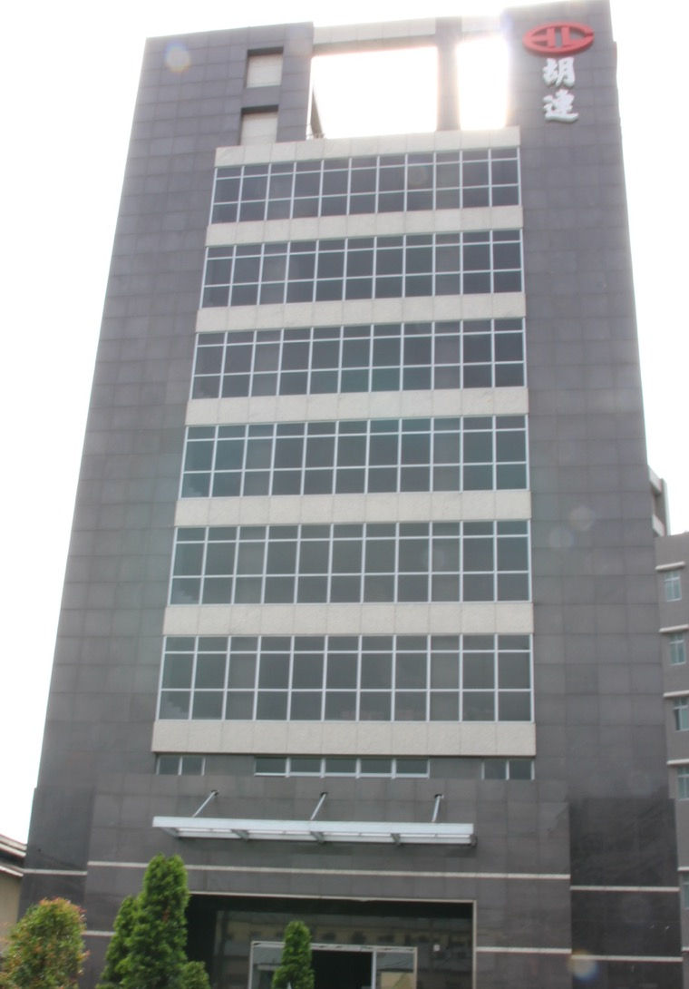




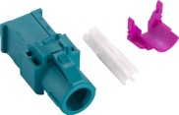
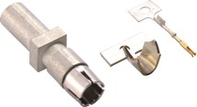
Company Profile
Foundation
1977年
Chairman
T.H. Chang
General Manager
S.C. Hu
Capital
TWD $996.5 Millions
Main Products
Housing/Terminal/PCB junction box

Slide 4
Milestone
Hu Lane ( Taipei ) was established in 1977.
Hu Lane entered China market in 1999 and
successively established plant in Shenzhen、Nanjing and Dongguan；
Set up Hulane Electronic (Vietnam) in 2011；
Set up PT. Hulane (Indonesia) in 2017；
Set up Italy office in 2019.
Set up Europe Subsidiary in 2023.
IPO in OTC Market in 2003.
From 2006,Hu Lane is successively accredited for TS16949 、 ISO 14001、
TÜV NORD ISO 14001:2015 and VDA6.1 .
Nanjing laboratory got CNAS National Laboratory Certification in 2009.
Taipei laboratory has attained ISO/IEC17025 in 2015.
Set up Yangzhou Lear Hulane automotive parts trading company with Lear in 2021.
Taipei new headquarter is completed in 2022.
Acquired 100% equity of Taipei Shangho and Jiaxing Shangho to strengthen vertical integration and expand product lines in 2022.
Hu Lane ( Taipei ) obtained 14064 greenhouse gas check fair third-party assurance certification
in 2022

Slide 5

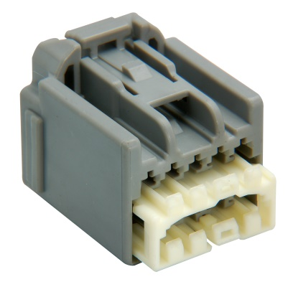
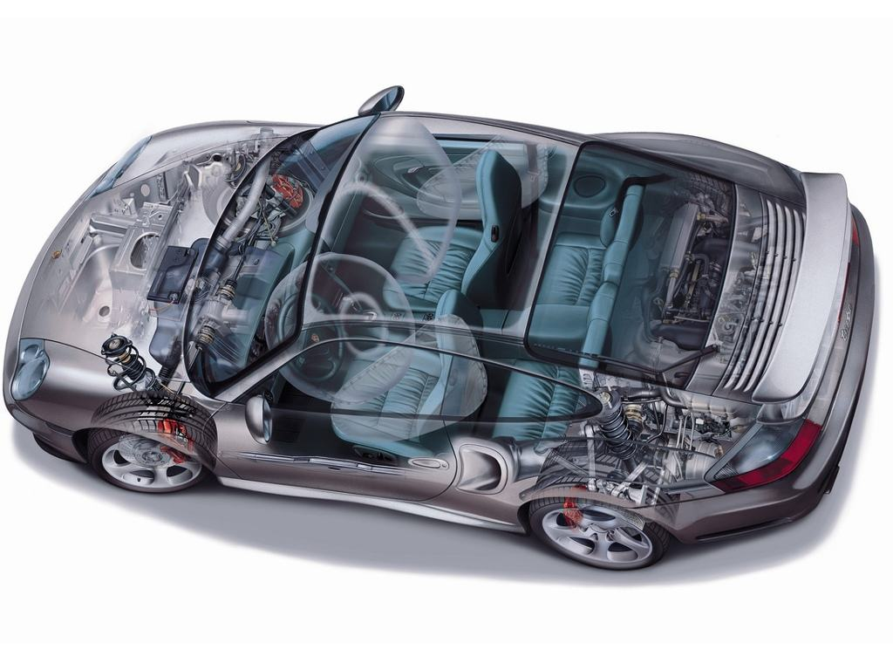
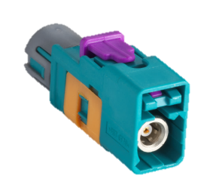
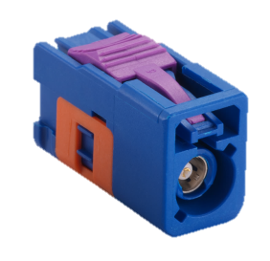
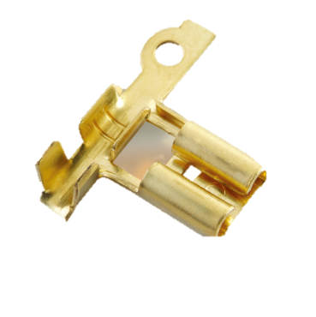
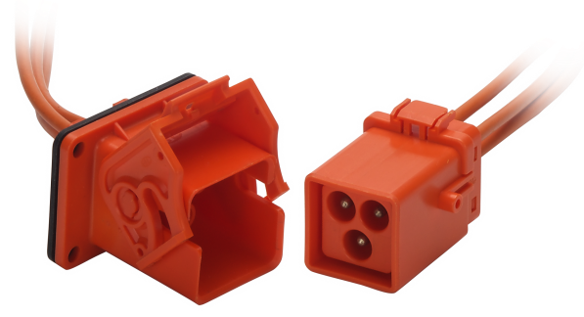
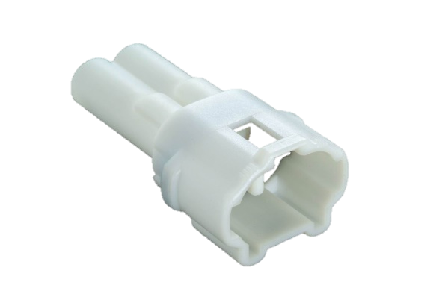
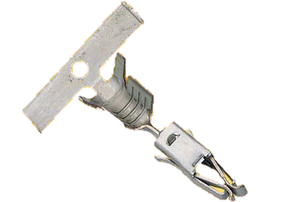
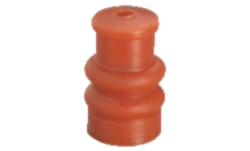
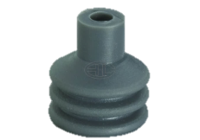
Main Products
Instrument
Panel
Oriented toward the high quality and technique
Hu Lane Can customize the best connector solution to wire harness and Connect the World with our efficient service
High Frequency
Fuse
EV Connector
Terminal
Waterproof
Connector
Rubber Seals

Slide 6

The automotive supply chain
Raw Material Manufacturer
Material
Tier 3/ 4/ 5
Part
Tier2
is here
Part
Tier1
Spare Parts
Part
Car Manufacturer
Vehicle/Spare Part
National Distributor
Vehicle/Spare Part
Dealer
Vehicle/Spare Part
Consumer

Slide 7

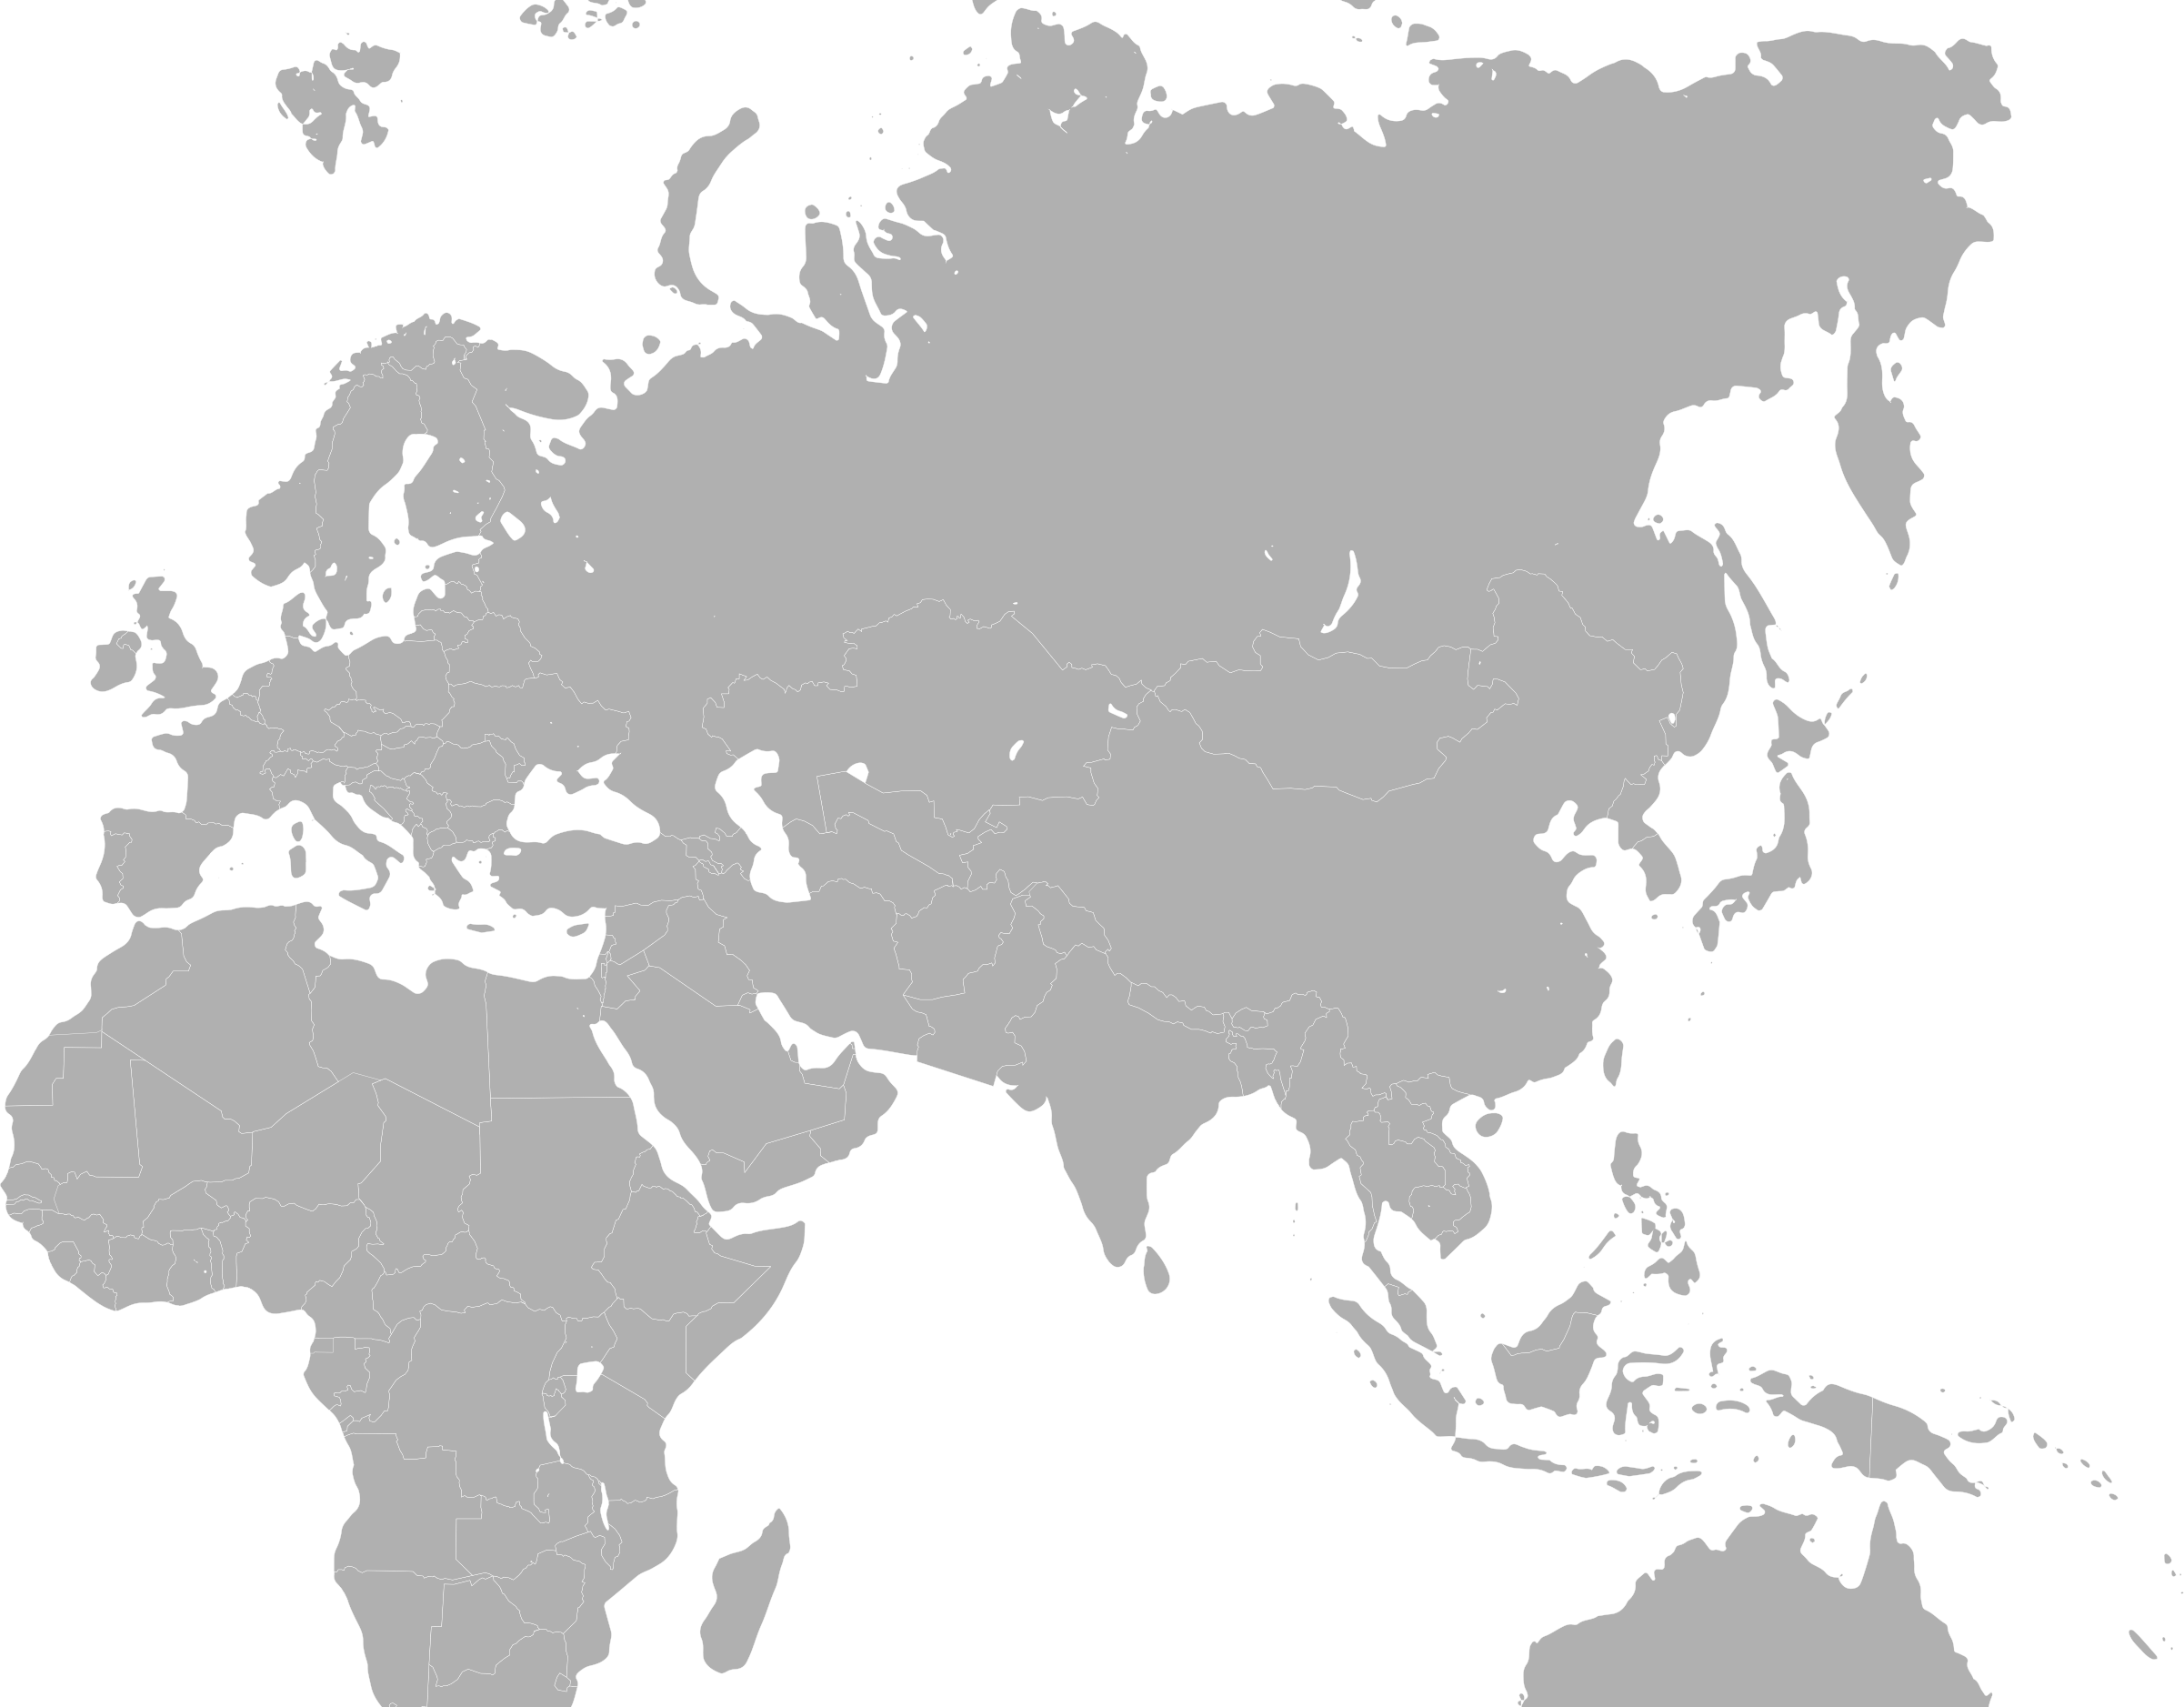
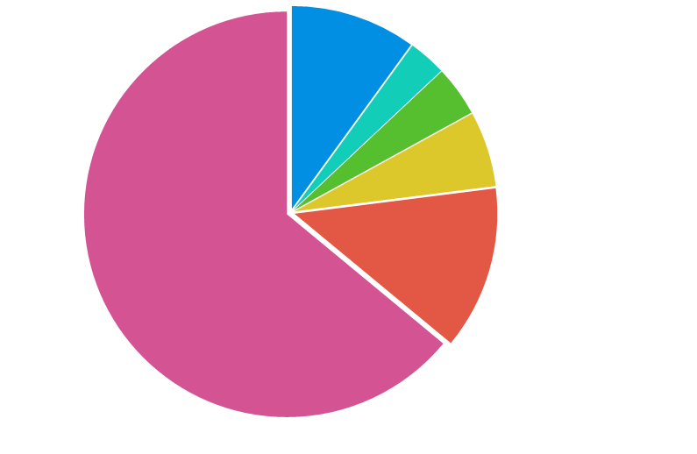
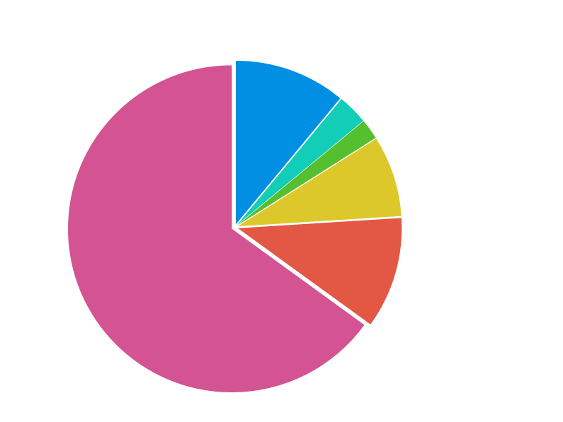
Sales Revenue by Geographic Area
Other Asia
6%
2023 Q3
Taiwan8%
2022
Vietnam3%
China 78%
Indonesia3%
Other Asia 5%
Outside of
Asia 5%
China 73%
Outside of
Asia8%
Taiwan 6%
Vietnam 2%
Taiwan10%
2021
Vietnam 3%
Indonesia 4%
Indonesia 3%
Other Asia 6%
China 65%
Outside of
Asia 13%

Slide 8
Capacity
Category | Press Machine |  | Injection Machine |  | Rubber Machine |  | %of total capacity
Facility Location | amount | % | amount | % | amount | %
Taipei | 34 | 38% | 59 | 23% | - | - | 25%
Nan Jing | 24 | 27% | 106 | 41% | 13 | 76% | 39%
Vietnam | 6 | 7% | 47 | 18% | - | - | 15%
Dongguan | 24 | 27% | 40 | 16% | 4 | 24% | 19%
Indonesia | 2 | 2% | 5 | 2% |  |  | 2%
Total | 90 | 100% | 257 | 100% | 17 | 100% | 100%

Slide 9
2023Q2 Financial Highlights
In NTD thousands | 2023 Q2 | 2022 Q2 | 年變化
Operating Revenue | 1,578,730 | 1,412,174 | 12%
Gross Margin | 29% | 28% | 1%
Operating Margin | 13% | 13% | -
Profit before income tax | 158,344 | 179,555 | 12%
EPS(NTD) | 0.73 | 1.05 | 30%
Net cash generated from operating activities | 397,977 | 312,762 | 27%
Capital expenditures | 389,884 | 296,377 | 32%
ROE | 1.32% | 2.02% | 0.7%

Slide 10
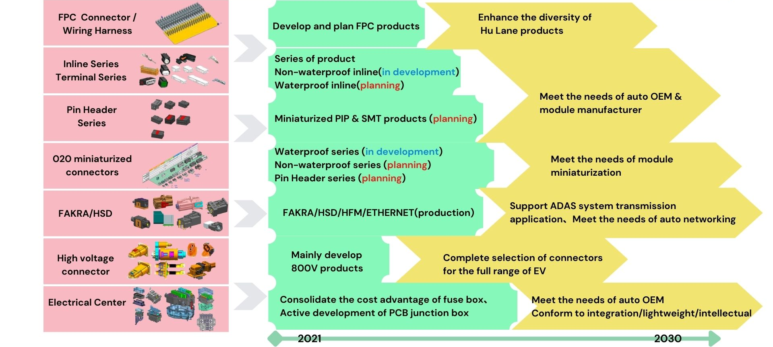
RD Roadmap

Slide 11






Market Development Strategy
China: Expand the penetration in existing customers and develop new customers
OEM | 2023/1~9 number of production(YoY) | Cooperation with OEM
 | 2,103,294(77％) | Continued acquirement of new product development.
 | 1,180,665(26％) | New models adopt fuse box platform.
 | 1,162,418(15％) | Continued acquirement of new product development.
 | 1,099,646(31％) | Continued acquirement of new product development.
 | 718,553(-16%) | HL collaborated with the customer based on the functional requirements to design new products in new models.
 | 606,692(-36％) | New product introduction increases the penetration

Slide 12
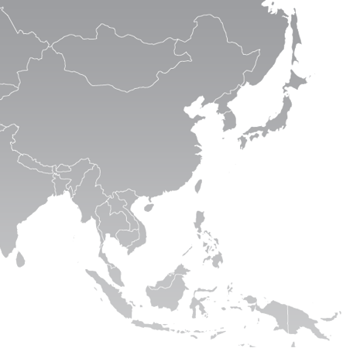
Market Development Strategy
Taiwan
Indonesia
Cooperate with electric motorcycle manufacturers, in addition to meeting the domestic market, there are opportunities for exporting overseas.
Set up Indonesia subsidiary to manage the auto and motorcycle connector market.
Global
Continue to work with global Tier-1 module suppliers for systematic integration development

Slide 13
Dividend Policy
Item ＼ Year | 2016 | 2017 | 2018 | 2019 | 2020 | 2021 | 2022
EPS Before Tax | 11.42 | 12.43 | 7.44 | 5.79 | 6.82 | 9.53 | 12.62
EPS | 9.24 | 10.00 | 6.00 | 4.78 | 5.59 | 7.91 | 10.03
Dividend | 6.0 | 8.0 | 4.0 | 3.25 | 4.0 | 5.0 | 5.6
Cash | 6.0 | 8.0 | 4.0 | 3.0 | 4.0 | 5.0 | *5.6
Stock | 0 | 0 | 0 | 0.25 | 0 | 0 | 0
Dividend Payout Ratio | 65% | 80% | 67% | 68% | 72% | 63% | 56%
* NTD1/per share is paid by Additional Paid In Capital

Slide 14
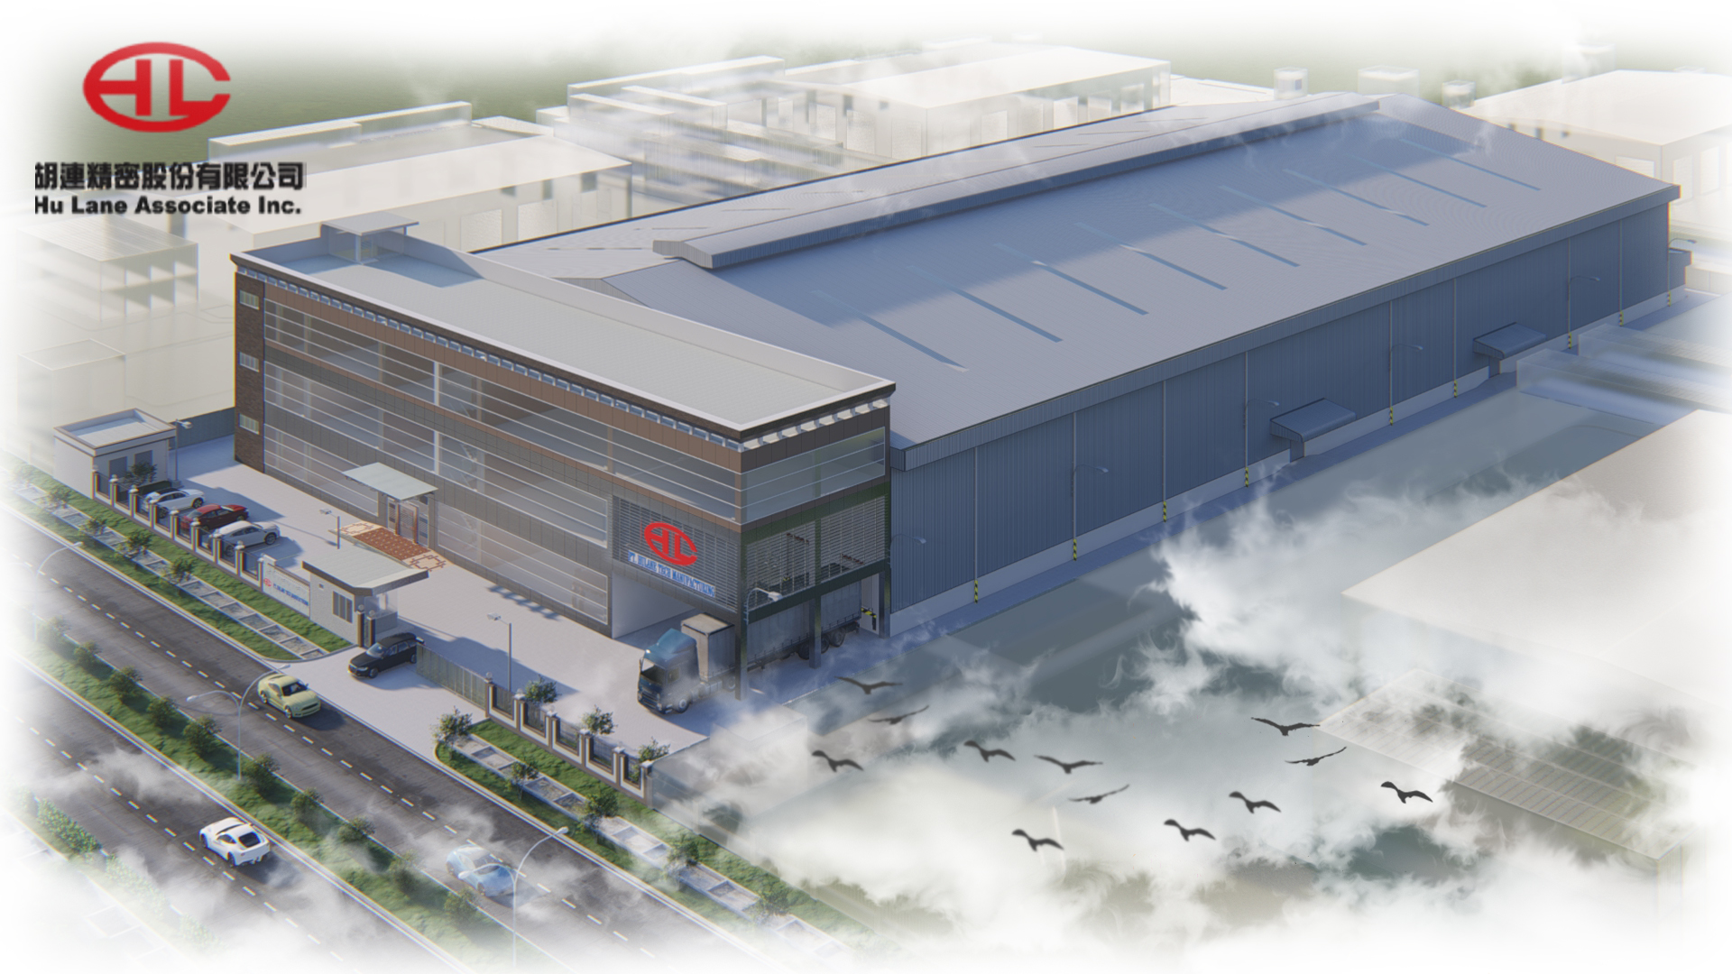
Connect the World
Hu Lane continued to invest in Indonesia. In March 2023,the new factory has started construction . The construction area is 14,249.72 ㎡ and planned with 3 floors of office building and 2 floors of production building.

Slide 15
Q&A

